Slide 1
SIX GREAT CITIES OF
THE PRE-MODERN WORLD
Prof. Chris Friedrichs
UBC
Fall 2020
Scroll down to see each week’s topic

Slide 2
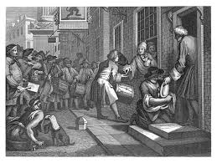
LONDON
The thriving capital city where the interaction of rich and poor was vividly captured in an 18th-century graphic novel.

Slide 3
VENICE
The wealthy city of canals, bridges, churches and palazzi which inspired the admiration and envy of the rest of Europe.

Slide 4
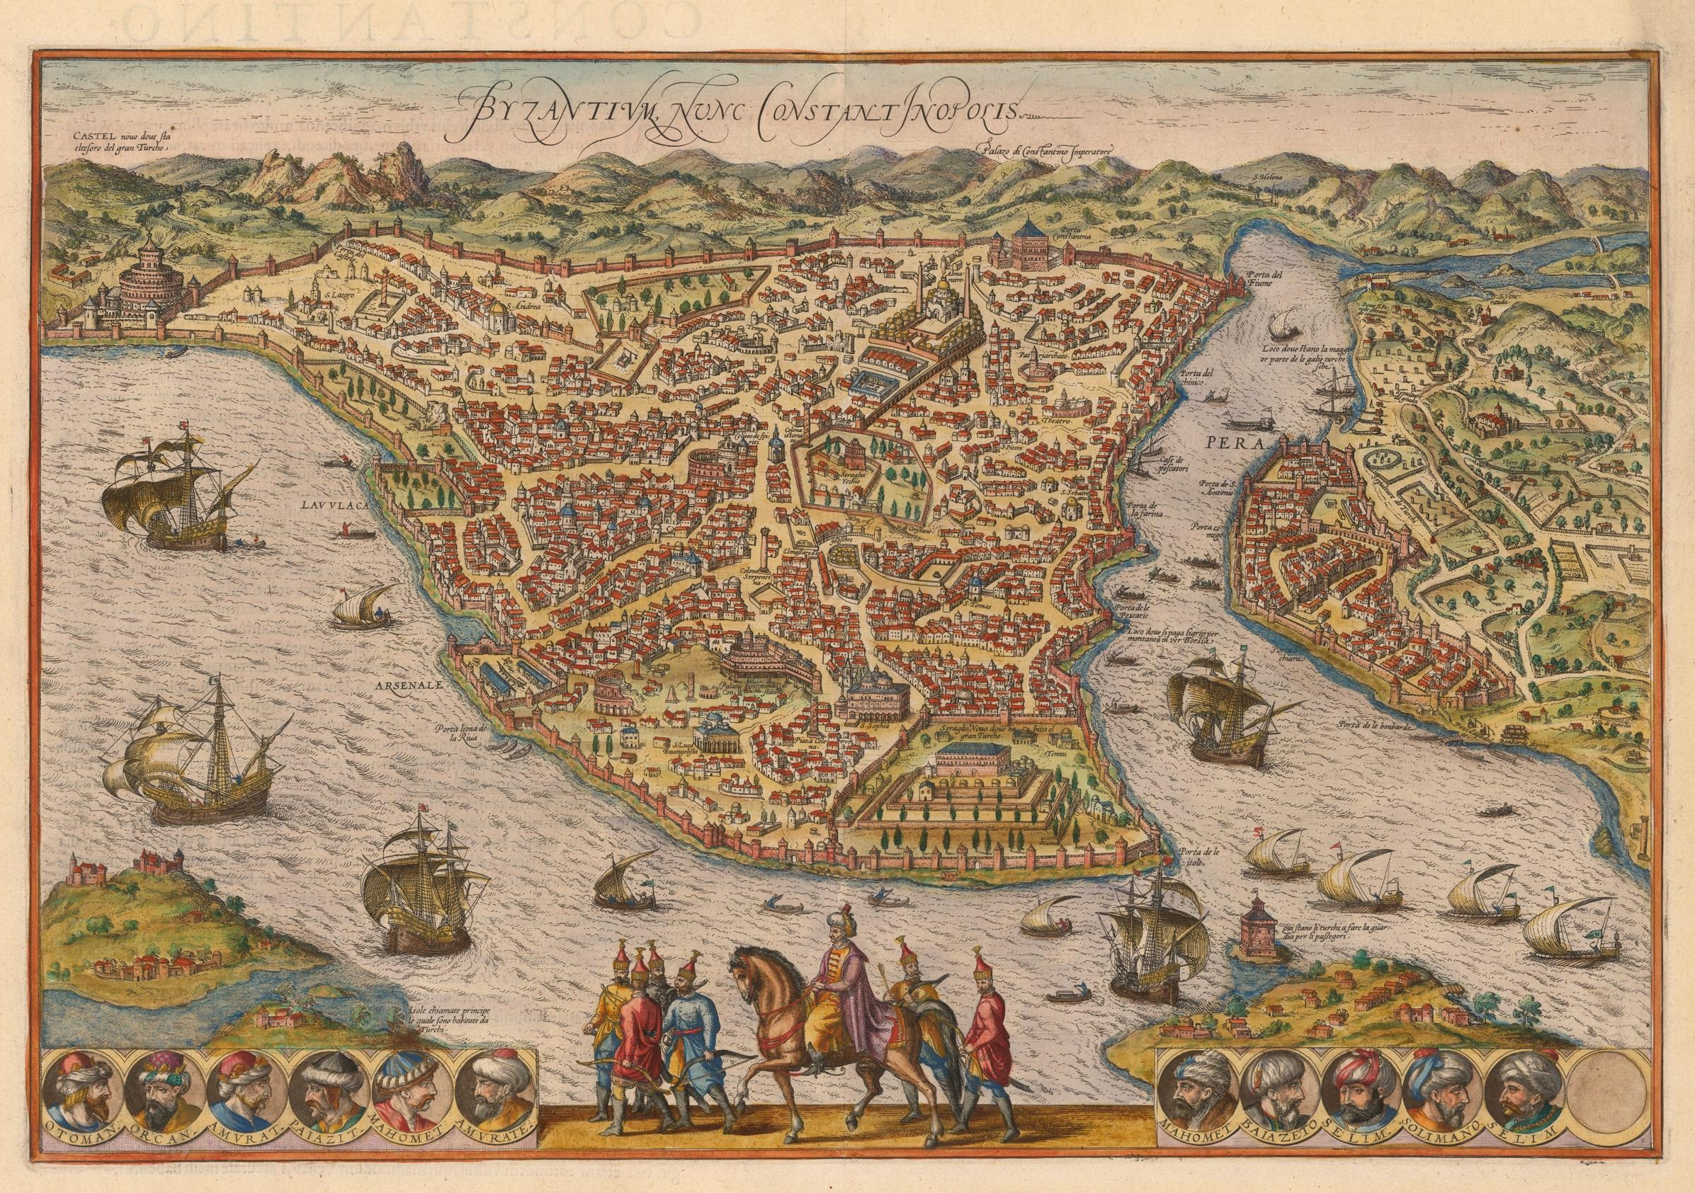
ISTANBUL
The opulent but turbulent Ottoman capital where Muslims, Christians and Jews lived in uneasy coexistence.

Slide 5
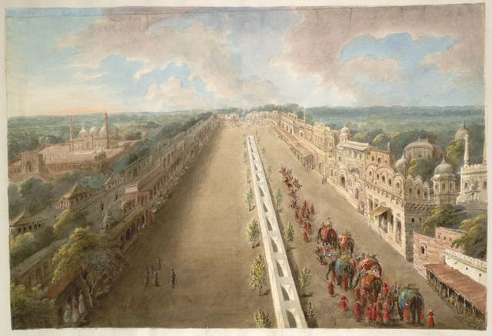
DELHI
The great imperial capital which was occupied, abandoned, and reestablished by restless Mughal emperors.

Slide 6
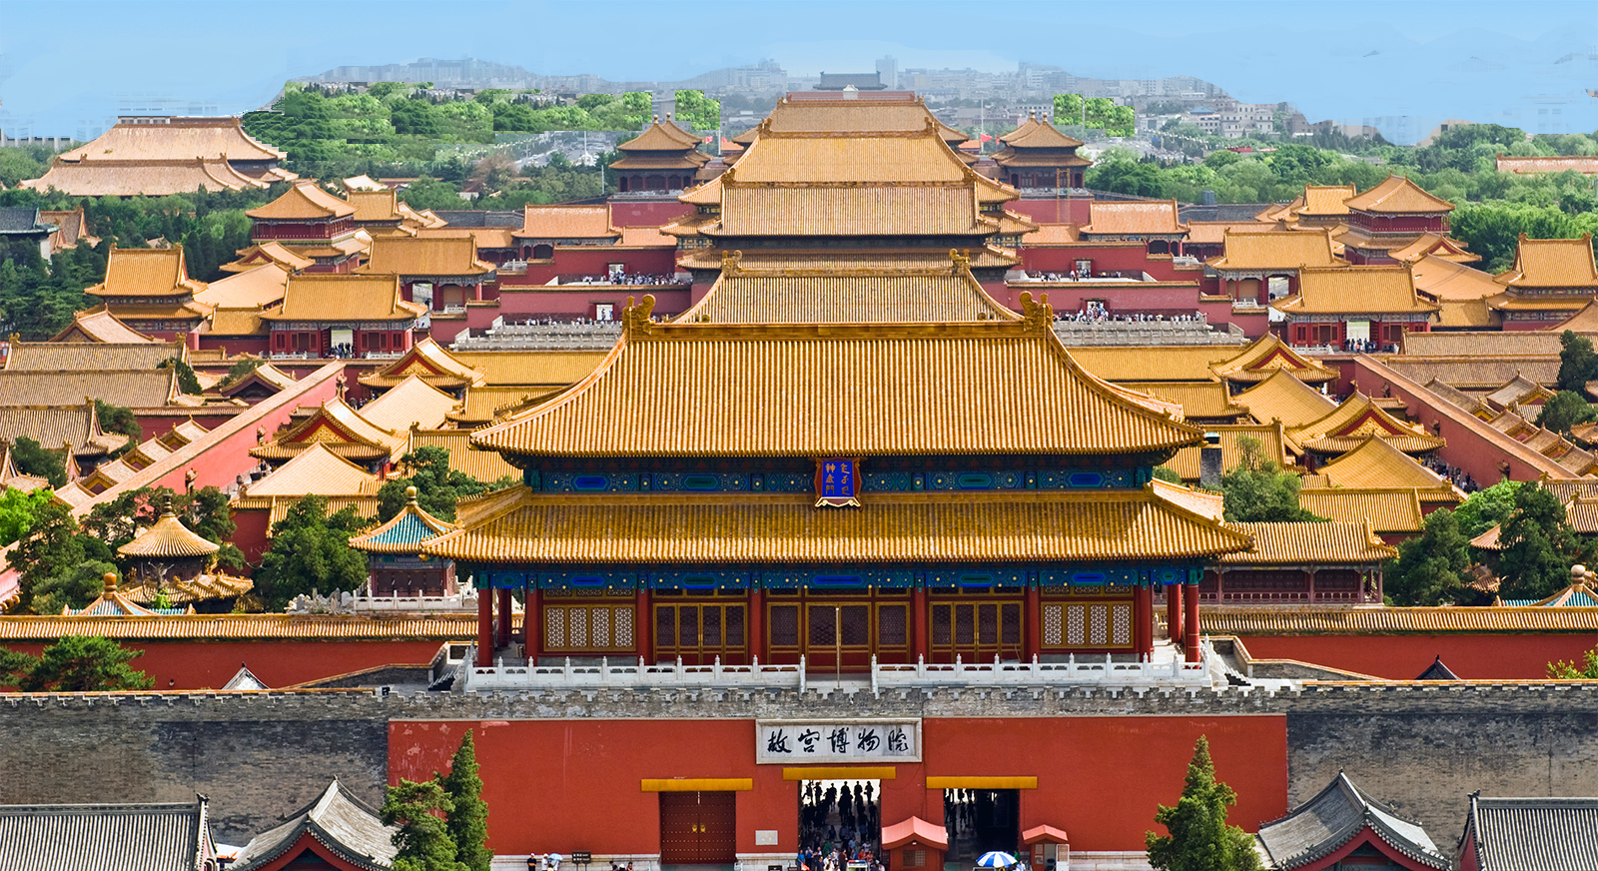
BEIJING
The huge metropolis whose “Forbidden City” was not forbidden to the thousands of people who served the Ming and Qing emperors.

Slide 7
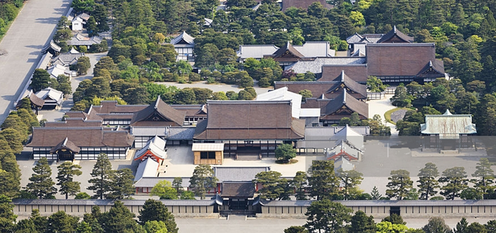
KYOTO
The historic capital of Japan where emperors continued to reign even long after they ceased to rule.

