Slide 1
PARALLEL LIVES:
Six Surprising Pairs
of
Remarkable People
Prof. Chris Friedrichs

Slide 2
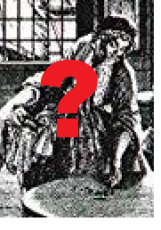
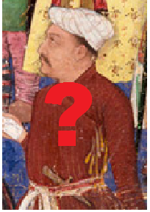
TWO TRAVELLING MERCHANTS
who wrote their own life stories
Glückel of Hameln
17th-century Germany
Banarasidas
17th-century India

Slide 3
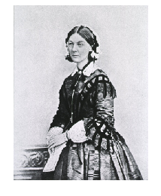
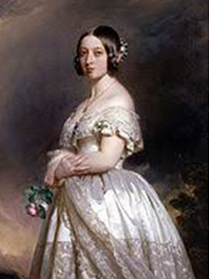
TWO TOUGH BRITISH WOMEN
who reshaped institutions
QUEEN VICTORIA
Born 1819
FLORENCE NIGHTINGALE
Born 1820

Slide 4
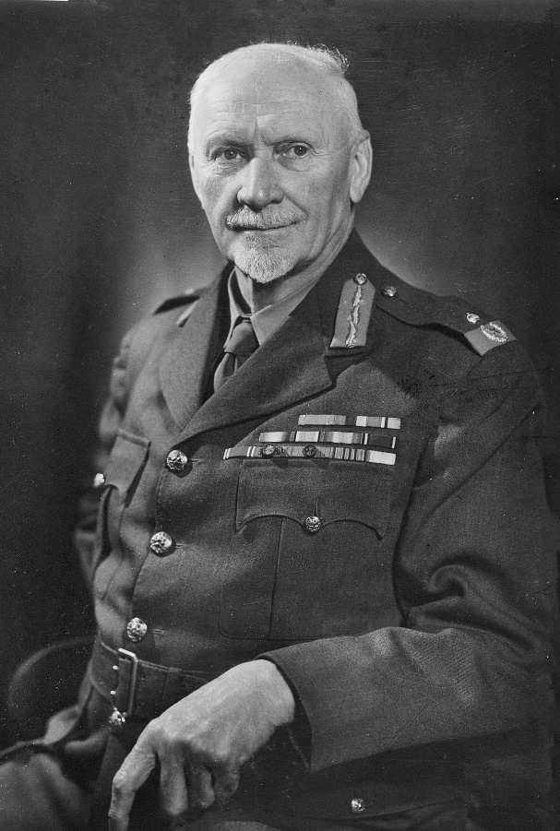
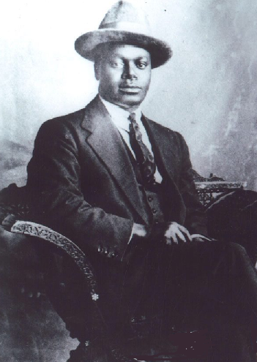
TWO SOUTH AFRICAN LEADERS
on opposite sides of the colour line
JAN SMUTS
Born 1870
PIXLEY KA-ISAKA SEME
Born 1881

Slide 5
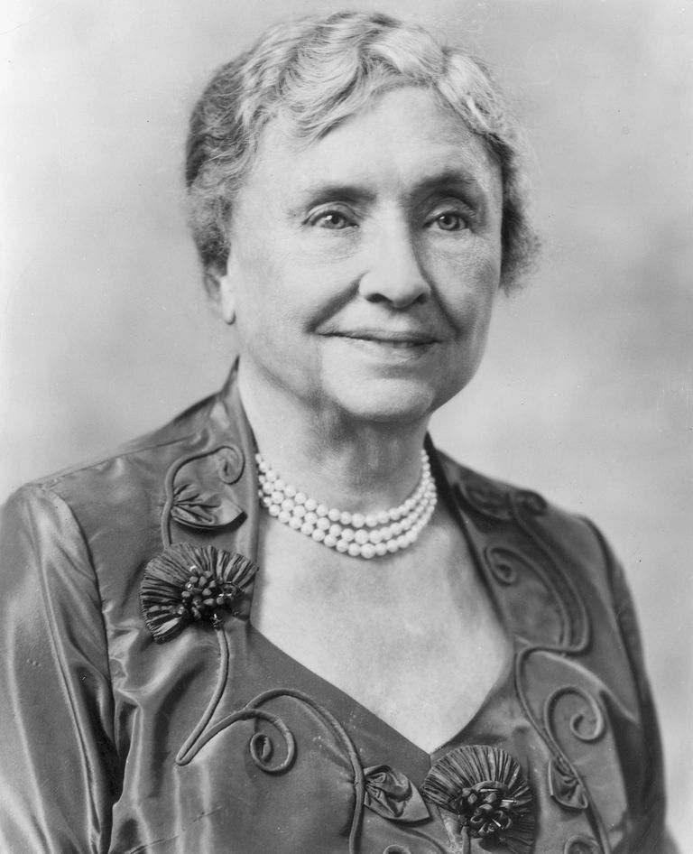
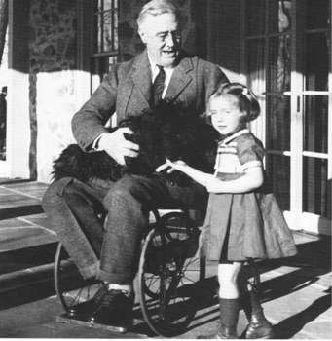
TWO FAMOUS DISABLED AMERICANS
who revealed / concealed their disability
HELEN KELLER
Born 1880
FRANKLIN ROOSEVELT
Born 1882

Slide 6
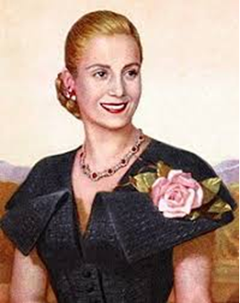
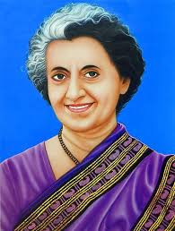
TWO FEMALE POLITICAL LEADERS
who were surprised to get power – but liked using it
EVA PERON
Born 1919
INDIRA GANDHI
Born 1917

Slide 7
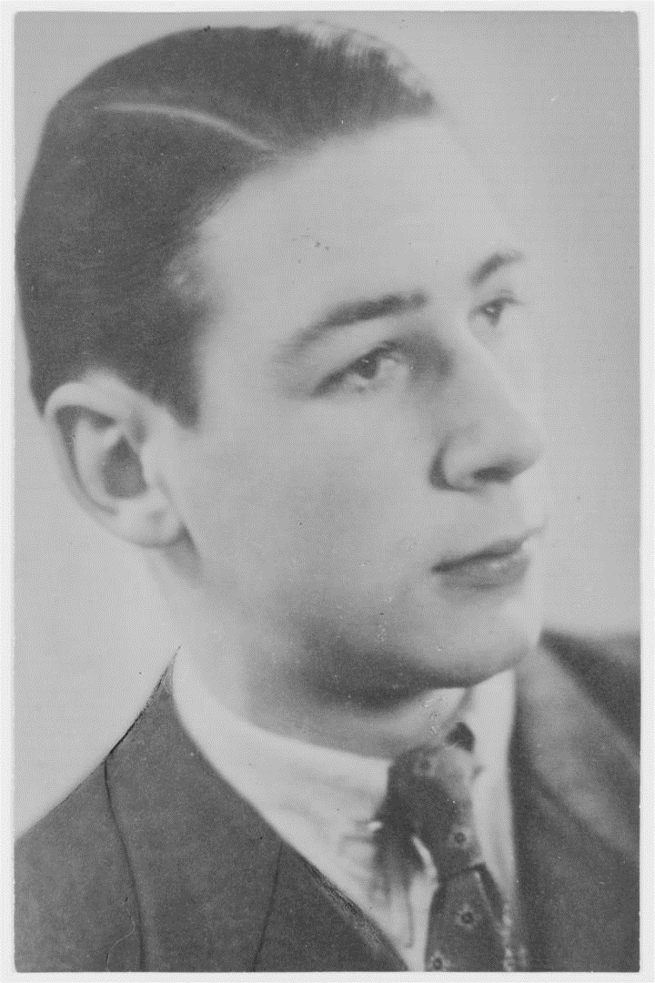
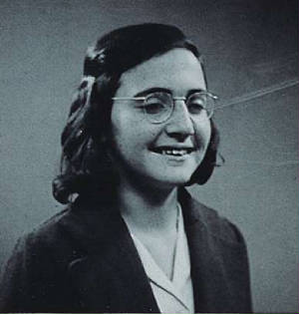
TWO YOUNG LIVES CUT SHORT DURING WORLD WAR II
WALTER SCHREIBER
Born 1926 in Frankfurt am Main
Died 1945
MARGOT FRANK
Born 1926 in Frankfurt am Main
Died 1945

