Slide 1
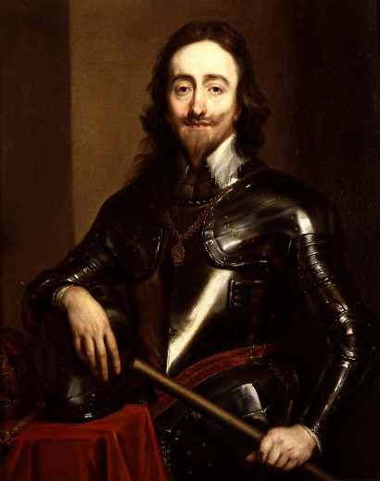
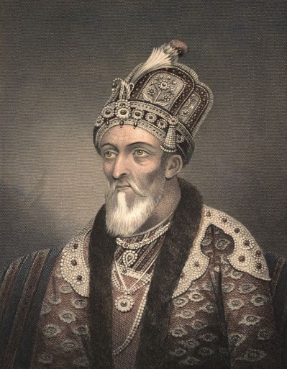
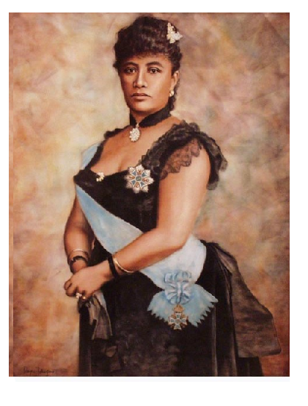
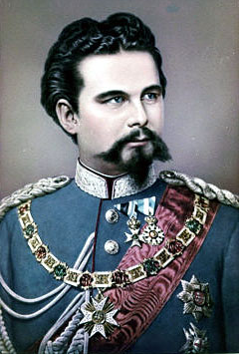
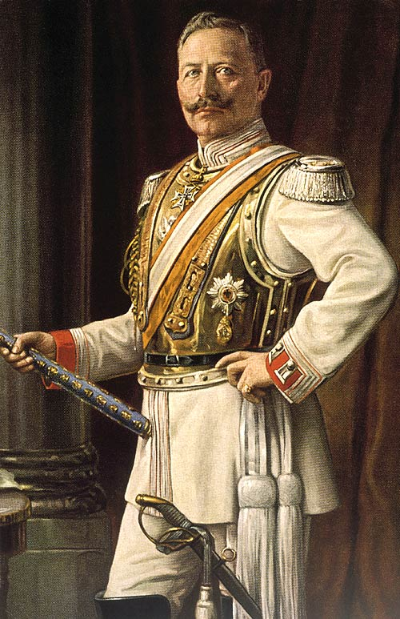
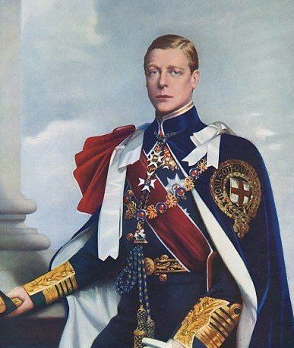
END-GAME
OF THRONES:
HOW SOME
REAL RULERS
LOST THEIR
CROWNS
Prof. Chris Friedrichs
UBC

Slide 2
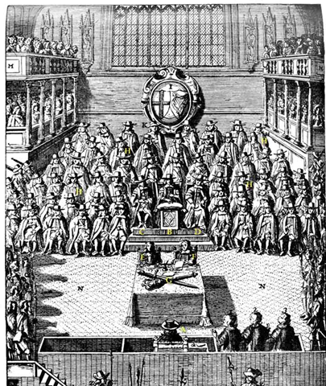
KING CHARLES I :
Put on trial, convicted, and beheaded…
WHY?

Slide 3
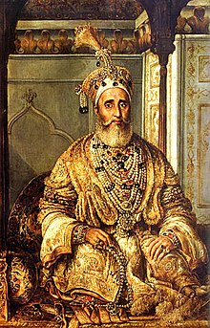
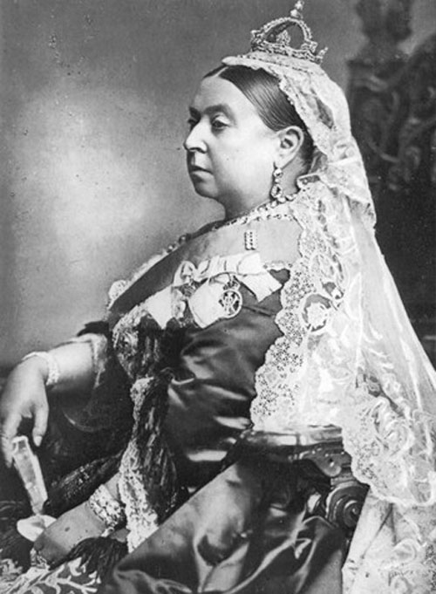
THE LAST MUGHAL EMPEROR
Deposed, banished, and replaced by the Queen of England….
WHY?

Slide 4
‘MAD’ KING LUDWIG OF BAVARIA
Declared insane, deposed, and replaced
by an even more insane king…
WHY?
?

Slide 5
QUEEN LILIUOKALANI OF HAWAII
Overthrown, arrested, forced to abdicate…
WHY?

Slide 6
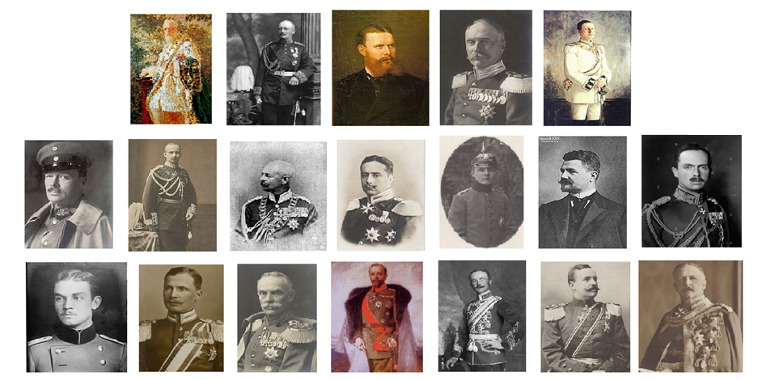
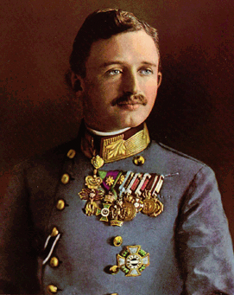
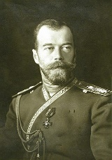
KAISER WILHELM II
Forced to abdicate, and you probably know why…
…..but he was not alone!

Slide 7
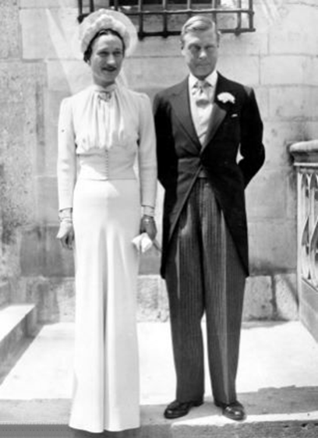
KING EDWARD VIII
Abdicated to marry “the woman I love…”
but maybe….

